Slide 1

Lecture 14: Dynamic Bayes Nets
Artificial Intelligence (CS 131)

Slide 2
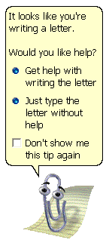
Uses of Bayes Nets
Older versions of MS Office used Bayes Nets to run the “Intelligent Assistant” program, including animated paper-clip, “Clippy”
Tracked user behavior to see if it should suggest help, and to determine what sort of help the user might need
Probably the least popular Bayes Net in the history of mankind!

Slide 3
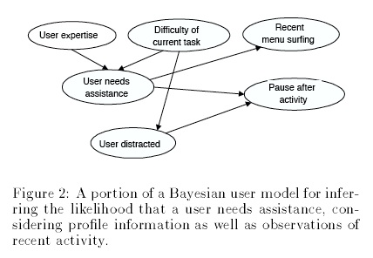
Microsoft Assistants
The BN was used to predict the “Needs Assistance” variable
Reasoning based on prior distributions over how hard certain things were to do in Office, and on how expert users were likely to be
Also used evidence, taken from things like menu use, clicking, waiting, re-doing or un-doing things…

Slide 4
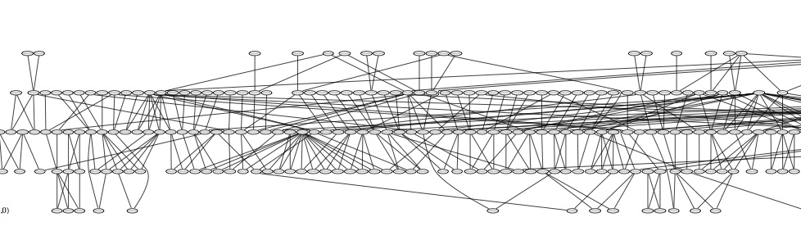
A More Successful Example
BN for tracking genetic tendencies behind pig diseases (something very important to the farm industry)

Slide 5
A Bayesian Model of Diabetes
Diabetes
Diet
Blood Sugar
Glucose Reading
Fatigue Levels
A simple Bayesian model of diabetes and blood sugar
Blood sugar changes over time, based on its prior level

Slide 6
Modeling Diabetes Over Time
Diabetes
Diet
Blood Sugar
(Time 1)
Blood Sugar
(Time 2)
Glucose Reading
Fatigue Levels
To build in temporal relations, we could duplicate the blood-sugar node, adding in effects over time
This provides a more complicated model, and becomes cumbersome when we are dealing with long time-spans, and many different time-steps

Slide 7
Temporal Probability Models
We would like to keep our model simple, and still represent long stretches of time
This is made possible where we have processes that are essentially the same at every time-step
Our models represent change over time:
States of model depend upon states at previous time(s)
Observations and other local variables at any point in time depend only upon the current state

Slide 8
Dynamic BN: a Temporal Model
Diabetes
Diet
Diabetes
Diet
Blood Sugar (Time t)
Blood Sugar (Time t+1)
Glucose Reading
Fatigue Levels
Glucose Reading
Fatigue Levels
Time t
Time t+1

Slide 9
States Depend upon Prior States
Diabetes
Diet
Diabetes
Diet
Blood Sugar (Time t)
Blood Sugar (Time t+1)
Glucose Reading
Fatigue Levels
Glucose Reading
Fatigue Levels
Time t
Time t+1

Slide 10
Observations Depend upon the Current State of the System Alone
Diabetes
Diet
Diabetes
Diet
Blood Sugar (Time t)
Blood Sugar (Time t+1)
Glucose Reading
Fatigue Levels
Glucose Reading
Fatigue Levels
Time t
Time t+1

Slide 11
Local Variables Are Not Observed, and Do Not Depend upon Prior Time-steps
Diabetes
Diet
Diabetes
Diet
Blood Sugar (Time t)
Blood Sugar (Time t+1)
Glucose Reading
Fatigue Levels
Glucose Reading
Fatigue Levels
Time t
Time t+1

Slide 12
Specifying Dynamic Bayes Nets (DBNs)
We must specify all of the following:
Transition model: probability of going from one state, X_{t}, to another, X_{t + 1}, at the next time-step
Observation model: probability of an observation, E_{t}, based on the current state
Prior distribution on initial state: P(X₀)
This then defines a complete joint distribution:

Slide 13
Some Basic Assumptions
Stationary process: the system works the same way at every point in time
Even if variables change over time, they change in the same way
Markov assumption: current system state depends only upon some finite number of previous states
Basic (first-order) Markov Process: state of system only depends on the one state immediately before
Second-order: state depends upon the prior two states
n-order: depends upon prior n prior states

Slide 14
Transition Model
Rain_{t-1}
Rain_{t}
Rain_{t+1}
Umbrella_{t-1}
Umbrella_{t}
Umbrella_{t+1}
Probability that system state will change over time
Stationary assumption: probabilities are the same for all times t
Markov assumption: state X_{t} is conditionally independent of all other states, given evidence about those that influence it
For a 1st-order model, this means:

Slide 15
Observation Model
Rain_{t-1}
Rain_{t}
Rain_{t+1}
Umbrella_{t-1}
Umbrella_{t}
Umbrella_{t+1}
Probability of observation, E_{t}, given current state, X_{t}
E_{t} is conditionally independent of everything else, given evidence about the local state:

Slide 16
Forms of Inference in DBNs
Filtering:
Expresses a belief state about the current state, given sequence of past evidence
Prediction:
Used to evaluate future possibilities based upon past evidence
Used in planning for the future
Smoothing:
Gives a better estimate of past states based on new evidence
Most likely explanation:
Gives state-sequence that is most likely based upon history
Useful in many tasks like speech recognition, robot localization

Slide 17
Inference: Filtering
Rain_{t-2}
Rain_{t-1}
Rain_{t}
Total Evidence (e_{1:t})
Current State (X_{t})
…
Umbrella_{t-2}
Umbrella_{t-1}
Umbrella_{t}
What is the probability of current state, given all evidence up to that point?

Slide 18
Recursive Belief Updates
The sequence of things we have seen over time (e_{1:t}) is our observation history
Nobody has infinite memory, however
When we want to figure out how likely some state is, given our observation history, we don’t want to have to remember every observation we ever had
We look for a way to update incrementally, so that we keep only a current probability at every time-step

Slide 19
Recursive Belief Updates
Best if we can make our current belief about the state of the system a function of our latest observation and our old belief (i.e., about what the state was before the latest observation):

Slide 20
Recursive Belief Updates
We can get the old belief as a function of the one before it:

Slide 21
Recursive Belief Updates
We then repeat this for the time step before that:

Slide 22
Recursive Belief Updates
And so on, until we get down to the base level:
(t – 3 more steps)

Slide 23
Updating Beliefs Over Time
All of this work is necessary only if we wait until lots of evidence comes in first, however
If we keep track of our belief-state from the beginning, we can update our current beliefs based only upon the immediate prior belief
3. …and compute a belief state about what the world is like at time t + 1
2. …we can take our latest observational evidence…
1. If we have already saved a belief state about what the world was like at time t…

